Slide 1
ISEN 614 Advanced Quality Control
Fall 2016 Project
Dwarkanath Prabhu
Venkata Kartik Mutya
Industrial & Systems Engineering
Texas A&M University
Texas A&M
ISEN 614
1/10

Slide 2
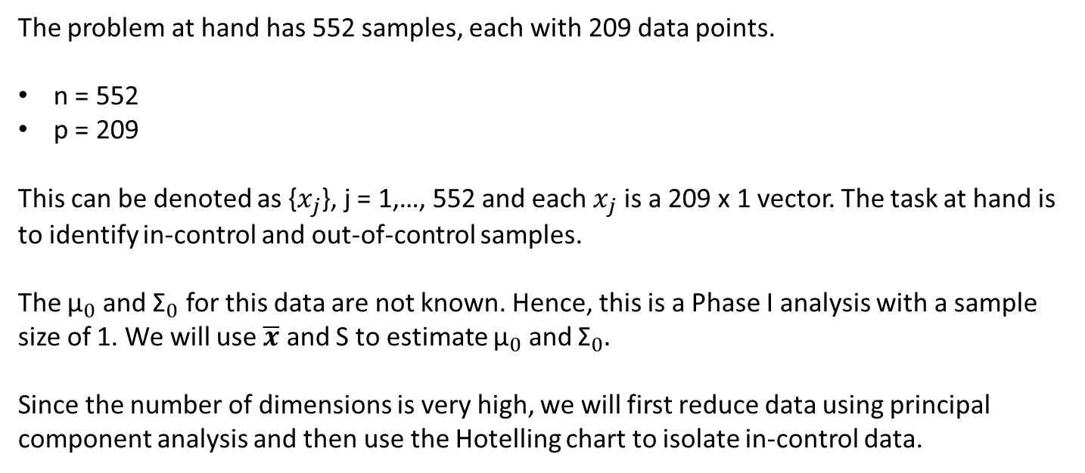
Understanding the Problem
The problem at hand has 552 samples, each with 209 data points.
n = 552
p = 209
This can be denoted as {$x_{j}$}, j = 1,…, 552 and each $x_{j}$ is a 209 x 1 vector. The task at hand is to identify in-control and out-of-control samples.
The ${\text{μ}}_{0}$ and ${\text{Σ}}_{0}$ for this data are not known. Hence, this is a Phase I analysis with a sample size of 1. We will use $\overline{x}$ and S to estimate ${\text{μ}}_{0}$ and ${\text{Σ}}_{0}.$
Since the number of dimensions is very high, we will first reduce data using principal component analysis and then use the Hotelling chart to isolate in-control data.
Texas A&M
ISEN 614
2/10

Slide 3
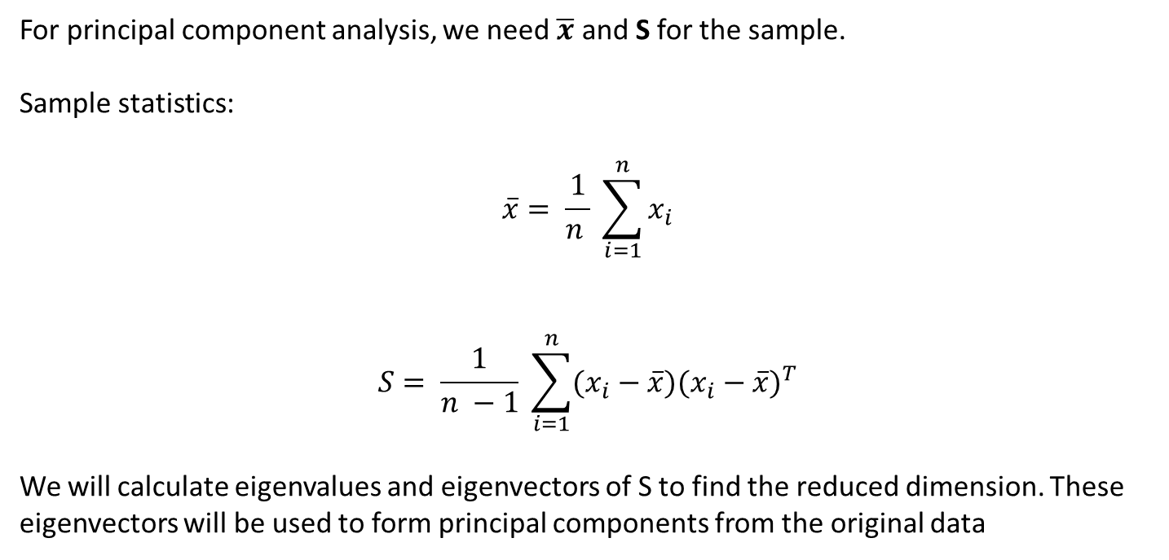
Data Reduction (1/3)
For principal component analysis, we need $\overline{x}$ and S for the sample.
Sample statistics:
$$\overline{x}= \frac{1}{n } \sum_{i=1}^{n}{x_{i}}$$
$$S= \frac{1}{n −1} \sum_{i=1}^{n}{{(x_{i}−\overline{x})(x_{i}−\overline{x})}^{T}}$$
We will calculate eigenvalues and eigenvectors of S to find the reduced dimension. These eigenvectors will be used to form principal components from the original data
Texas A&M
ISEN 614
3/10

Slide 4
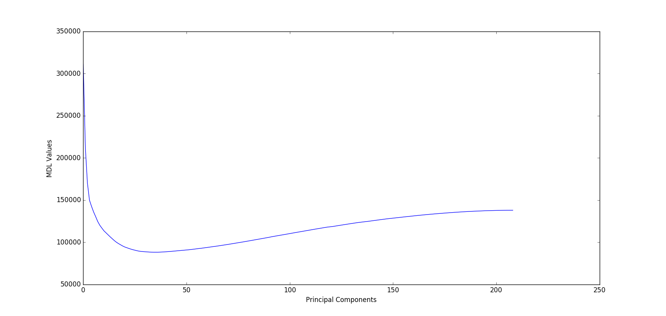
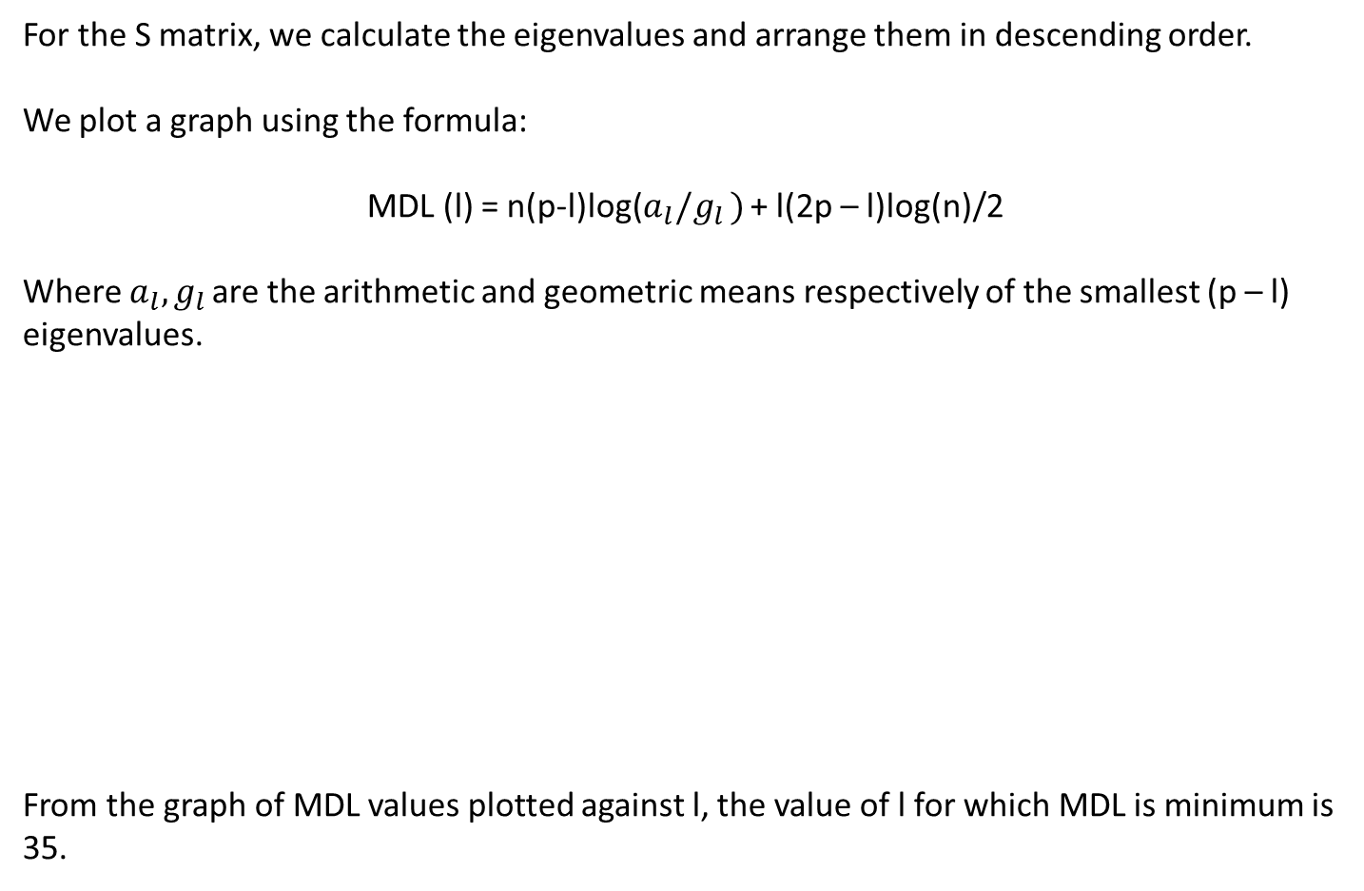
Data Reduction (2/3)
For the S matrix, we calculate the eigenvalues and arrange them in descending order.
We plot a graph using the formula:
MDL (l) = n(p-l)log($a_{l}/g_{l })$ + l(2p – l)log(n)/2
Where $a_{l},g_{l }$are the arithmetic and geometric means respectively of the smallest (p – l) eigenvalues.
From the graph of MDL values plotted against l, the value of l for which MDL is minimum is 35.
Texas A&M
ISEN 614
4/10

Slide 5
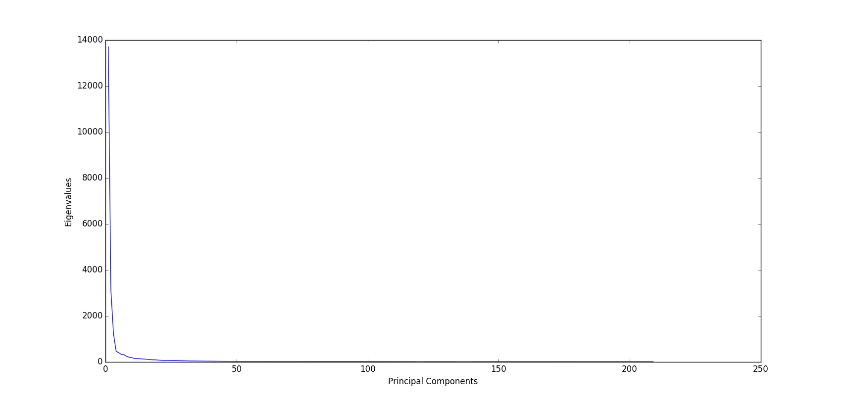
Data Reduction (3/3)
35 is still a very large number. Hence we look at the scree plot i.e. the plot of eigenvalues against the number of principal components
From the scree plot, it can be seen that there is a bend where the x-axis value is 4. We will thus choose only the first 4 principal components for our analysis.
Texas A&M
ISEN 614
5/10

Slide 6
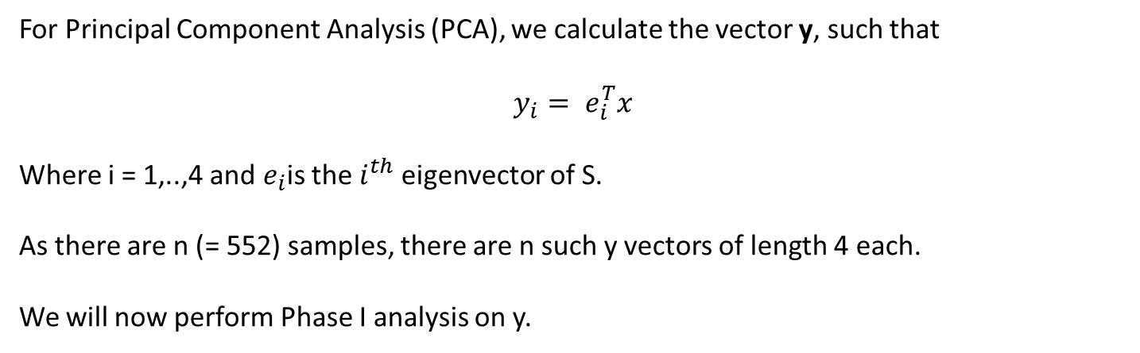
Principal Component Analysis
For Principal Component Analysis (PCA), we calculate the vector y, such that
$$y_{i}= e_{i}^{T}x$$
Where i = 1,..,4 and $e_{i}$is the $i^{th}$ eigenvector of S.
As there are n (= 552) samples, there are n such y vectors of length 4 each.
We will now perform Phase I analysis on y.
Texas A&M
ISEN 614
6/10

Slide 7
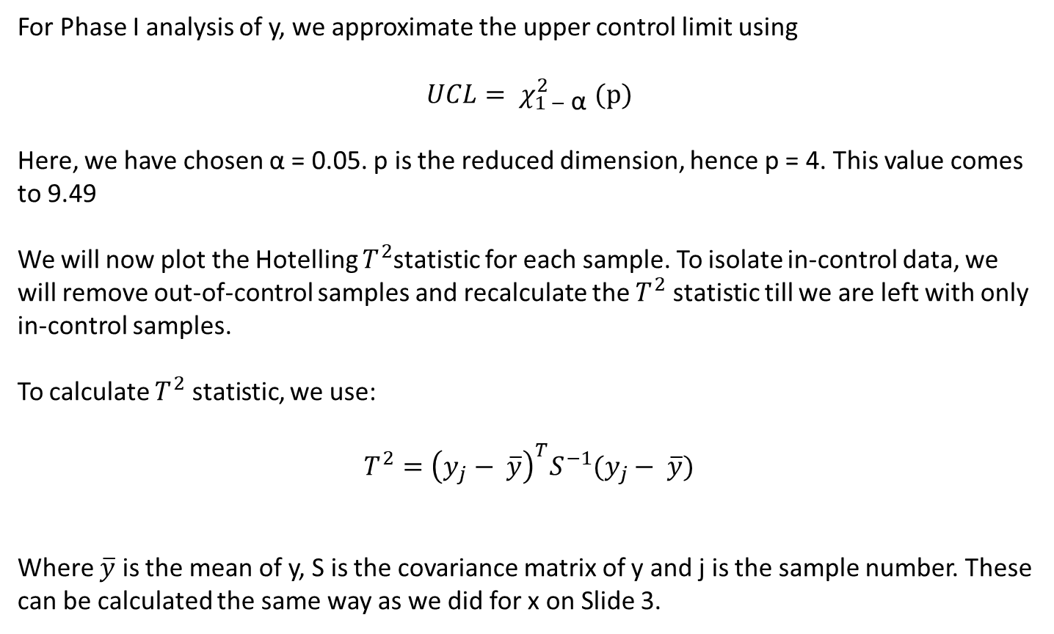
Phase I Analysis
For Phase I analysis of y, we approximate the upper control limit using
$${UCL= χ}_{1 − \text{α}}^{2} (p)$$
Here, we have chosen α = 0.05. p is the reduced dimension, hence p = 4. This value comes to 9.49
We will now plot the Hotelling $T^{2}$statistic for each sample. To isolate in-control data, we will remove out-of-control samples and recalculate the $T^{2}$ statistic till we are left with only in-control samples.
To calculate $T^{2}$ statistic, we use:
$$T^{2}={\left(y_{j}− \overline{y}\right)}^{T}S^{−1}(y_{j}− \overline{y})$$
Where $\overline{y}$ is the mean of y, S is the covariance matrix of y and j is the sample number. These can be calculated the same way as we did for x on Slide 3.
Texas A&M
ISEN 614
7/10

Slide 8
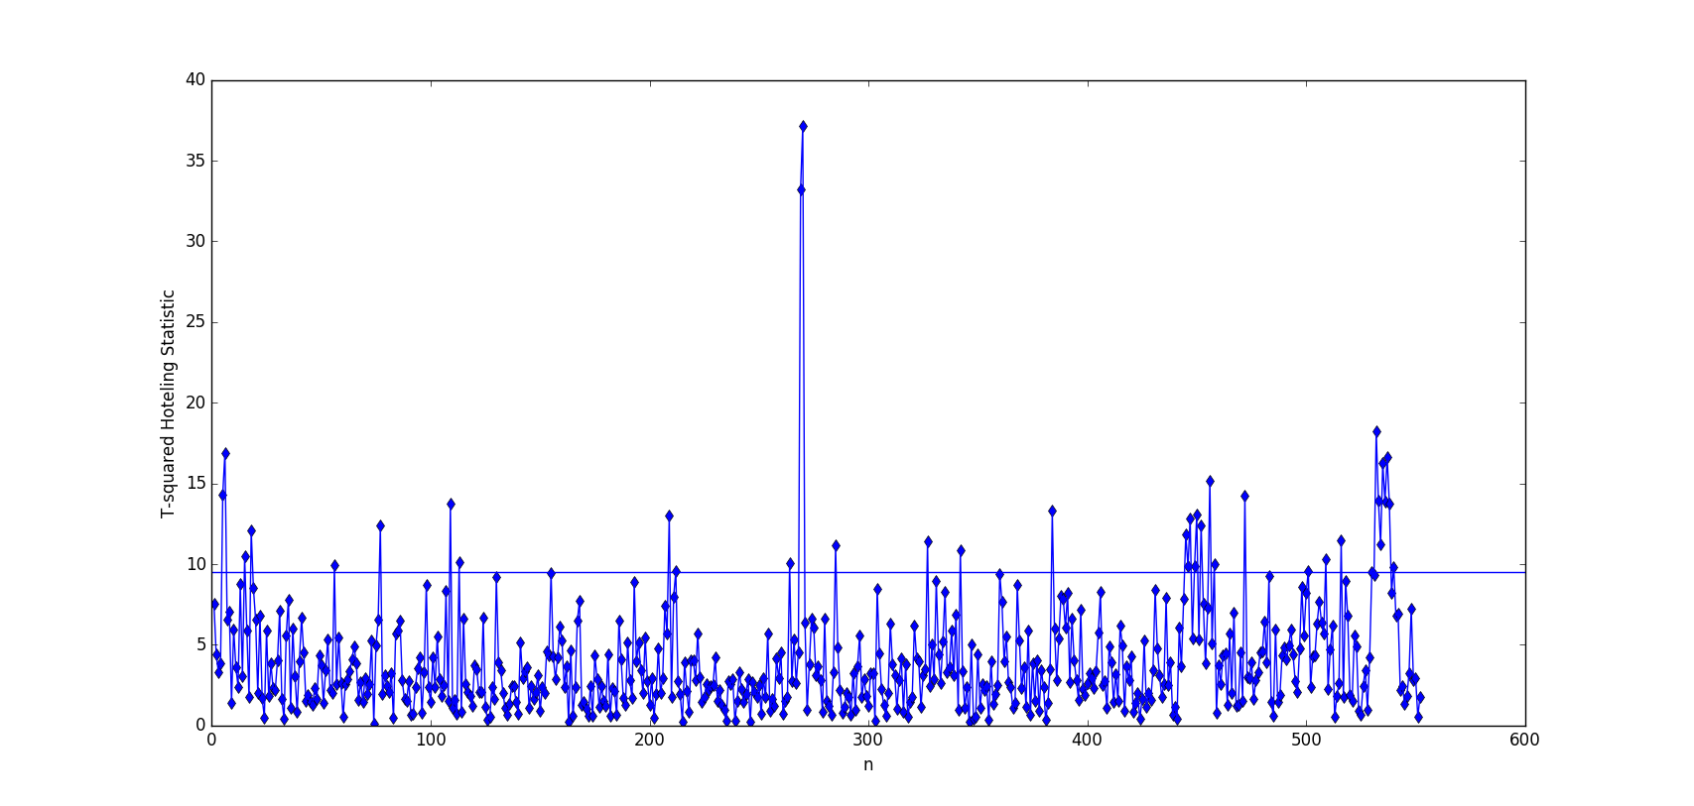
Hotelling Statistic First Iteration
In this plot, it can be seen that there are several samples that are out of control
Texas A&M
ISEN 614
8/10

Slide 9
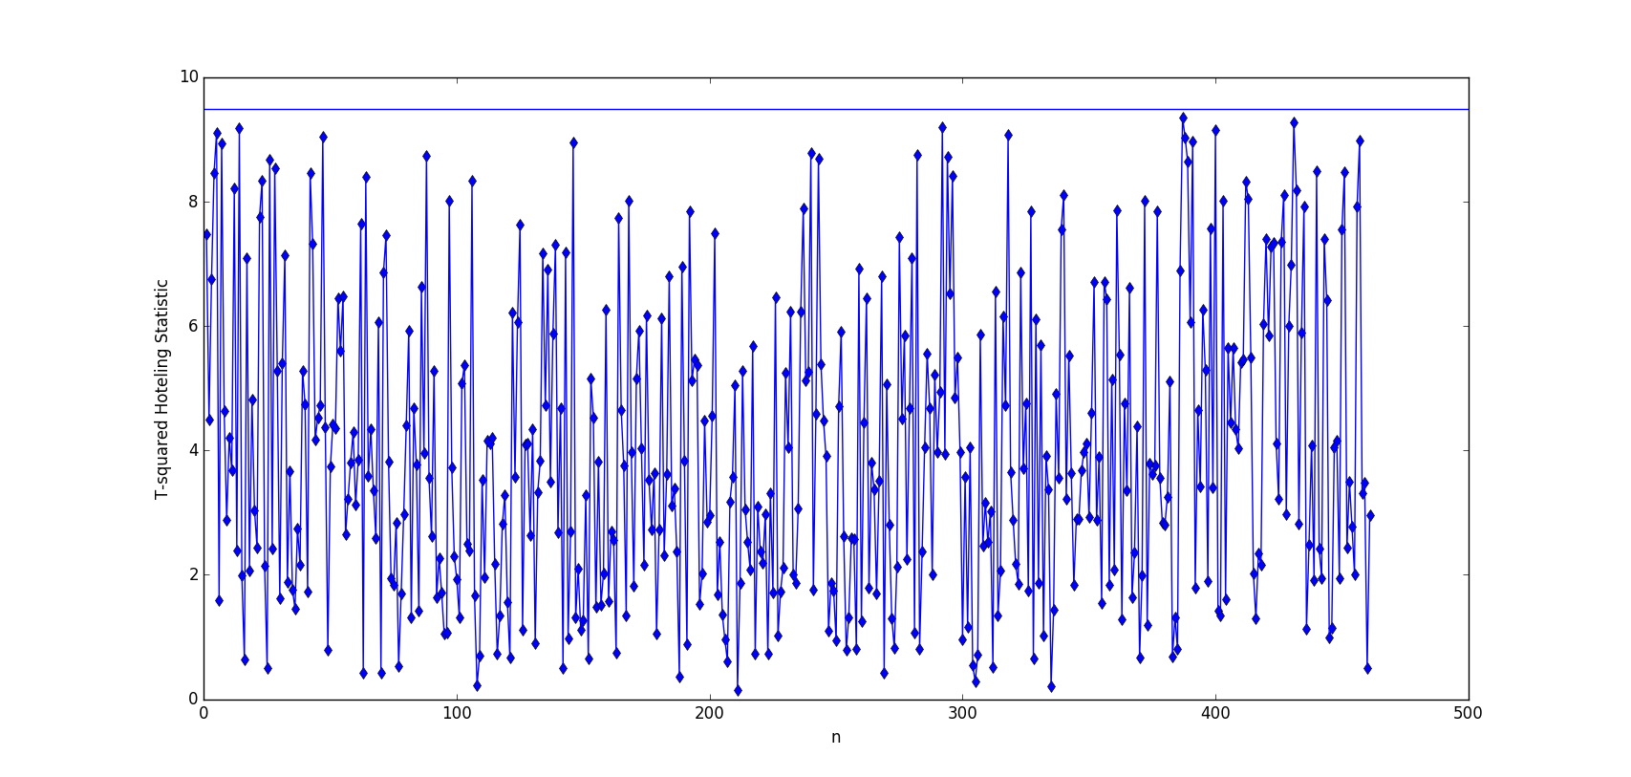
Hotelling Statistic In-Control Samples
In this plot, all samples are in control. In total there are 461 in-control samples.
Texas A&M
ISEN 614
9/10

Slide 10
Thank You
Texas A&M
ISEN 614
10/10

